Slide 1
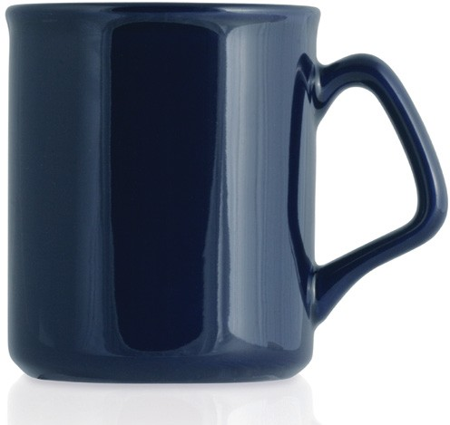
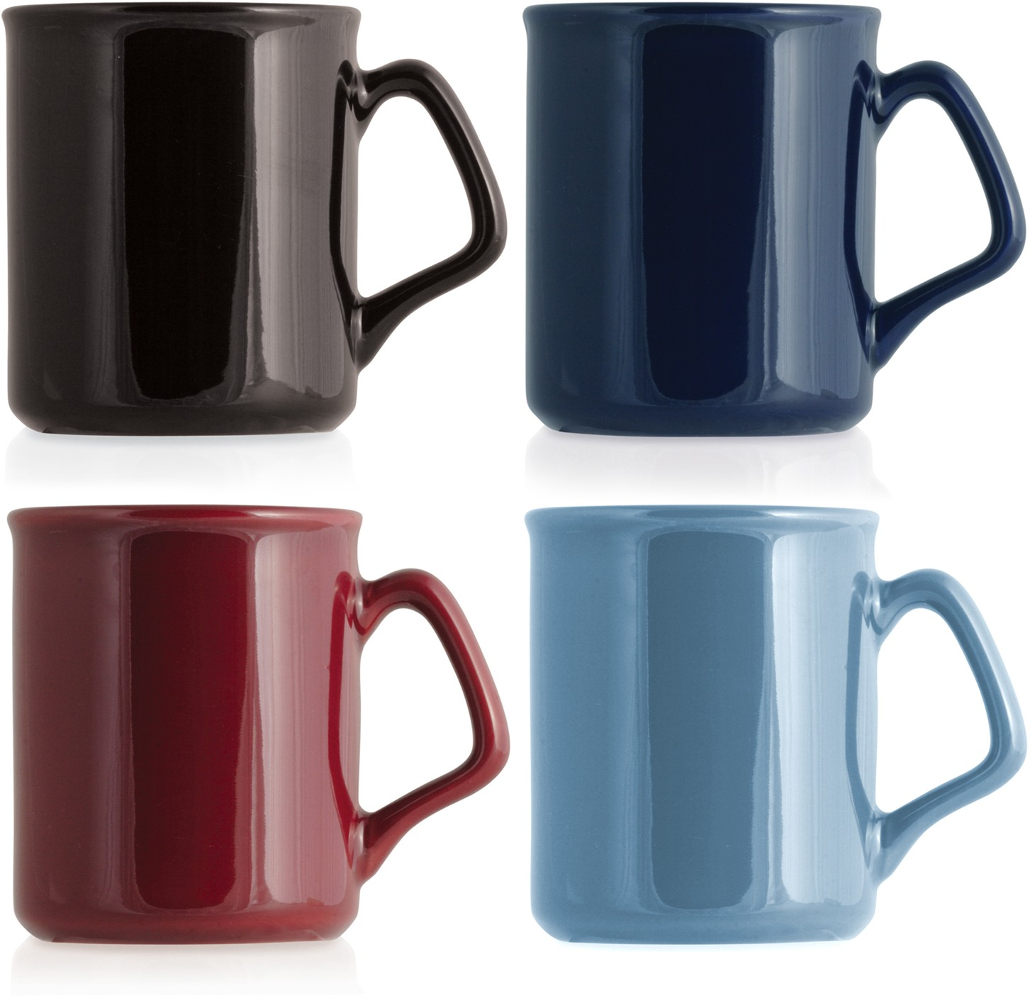
M106 Ceramic Mug Flare
A classic ceramic mug to carry your client’s logo - the perfect traditional promotional gift.
Capacity 325ml
Food grade ceramic
wrap
food
around
grade
print
ceramic
Packaging info
Product Dimension: Ø80 x 95mm Shipping Carton Qty: 36 Shipping Carton Size:
40 x 27.5 x 30.5cm (LxWxH)
Shipping Carton Weight (kg): 15
Print Area
185 x 70mm
Colours
A Black
Dark Blue
Maroon
G Cyan

