Slide 1
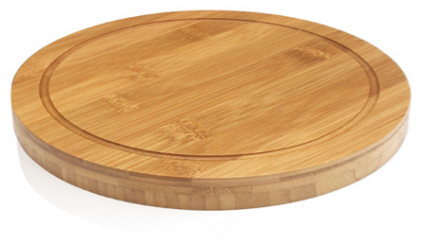
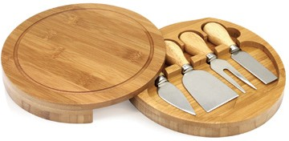
L478 Cheese Set 5pc
wine &
cheese
This clever cheese set gift comes with cheese knives and slicers and can be laser engraved on the wooden board with your client's logo.
Ideal for picnics or events, food lovers will appreciate this promotional gift.
Circular cheese board
Clever, stylish swivel lid
4 handy utensils
Packaging info
Product Dimension: Ø200 x 32mm
Shipping Carton Qty: 12 Shipping Carton Size:
14.5 x 11 x 21cm (LxWxH) Shipping Carton Weight (kg): 9
Engrave Area
80 x 30mm

