Slide 1
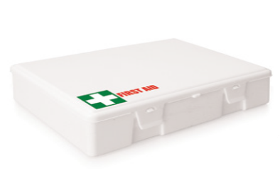
FA108 First Aid Kit Large 49pc
When emergency strikes, these first aid kits are ideal to have on standby; a sensible and practical place to position and promote your client's brand in an essential area.
49pc Emergency First Aid Pack
15x large plasters
8x alcohol wipes
4x moist towelettes
2x PBT bandages
1x triangular bandage
10x non-woven pads
1x pair latex gloves
2x safety pins
1x scissors
1x paper tape
1x emergency blanket
1x safety vest
1x dynamo torch with internal battery
1x First Aid information booklet
great
for the
work site
Packaging info
Product Dimension: 250 x 170 x 80mm Shipping Carton Qty: 20
Shipping Carton Size: 57x 40 x 47cm (LxWxH) Carton Weight (kg): 13
Print Area
Screen: 190 x 85mm Full Colour Digital: 80 x 30mm
Colour
White

