Slide 1
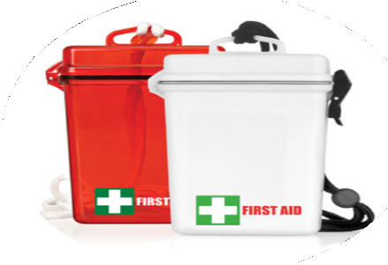
FA104 First Aid Kit Waterproof 21pc
Ideal for watersports or outdoor applications, these waterproof promotional first aid kits will display your client's logo in the best and most caring light.
21pc Waterproof First Aid Kit
Waterproof container protects the contents
5x large plasters
4x alcohol wipes
1x PBT bandage
1x triangular bandage
5x non-woven pads
2x safety pins
1x scissors
1x paper tape
1x First Aid information booklet
water-
proof
Packaging info
Product Dimension: 155 x 105 x 40mm Shipping Carton Qty: 100
Shipping Carton Size:
55 x 46.5 x 35.5cm (LxWxH)
Carton Weight (kg): 13
Print Area
40 x 50mm
Colour
A Red transparent B White

