Slide 1
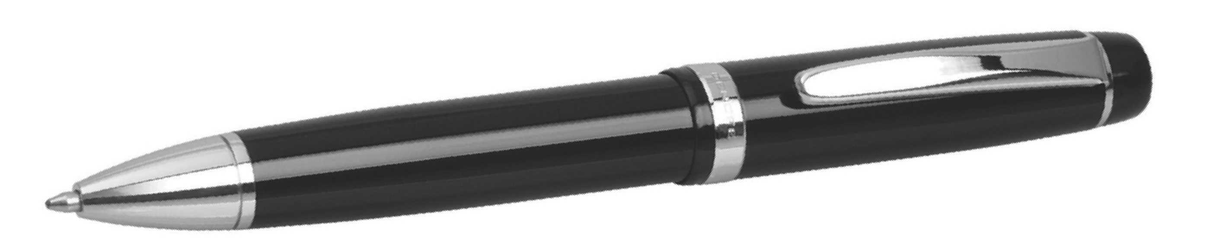
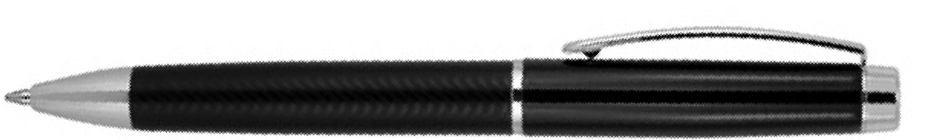
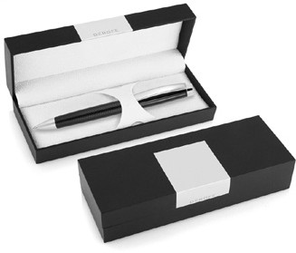
DER121 Metal Pen Ballpoint Derofe Pattern Black
Decorated with a delicate, understated ripple pattern, this pen is as pleasant to behold as it is to write with.
Features a Swiss-made Derofe Metal refill (1mm tip, black ink) rated for 9,300m, twist action, and a smart, stylish gift box.
Decoration methods include pad print, digital print, and mirror chrome engraving.
*Pricing includes a 1 position laser engraved logo on the upper barrel. Setup and freight charges apply.
Twist Action
Retractable ballpoint
Black ink
FREE
Swiss
laser
made
engrave*
ballpoint
refill
Packaging info
Shipping Carton Qty: 500 Shipping Carton Size:
34.5 x 29.5 x 38cm (LxWxH) Carton Weight (kg): 19
Colours
Black
Engrave Area
Engrave (upper barrel): 40 x 7mm
Engrave Colour: Mirror finish
FREE
gift box
FREE
2 year
warranty

