Slide 1
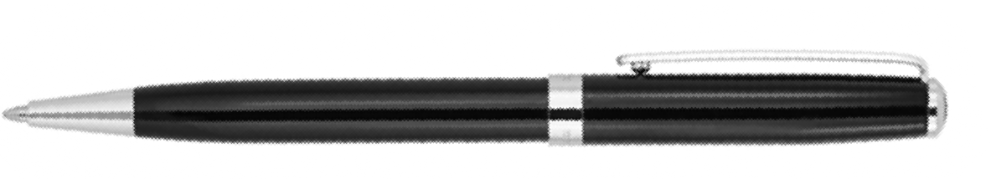
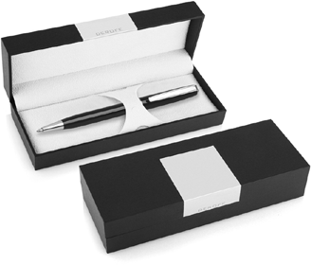
DER114 Metal Pen Ballpoint Derofe Connoisseur
The Connoisseur Black Ballpoint Pen, with chrome trim, is presented by Derofe Fine Writing Instruments in an elegant giftbox. The twist action, retractable black ballpoint has print/engrave included.
Available pad printed or laser engraved with your client's promotional logo to the upper barrel or choose to personalise with the recipient's name.
Derofe metal refill, made in Switzerland - 1.0mm - 9,300m.
*Pricing includes a 1 position laser engraved logo on the upper barrel. Setup and freight charges apply.
Twist Action
Retractable ballpoint
Black ink
FREE
Swiss
laser
made
engrave*
ballpoint
refill
Packaging info
Shipping Carton Qty: 500 Shipping Carton Size:
33.5 x 17.5 x 33.5cm (LxWxH) Carton Weight (kg): 18.5
Colours
Black CT
Engrave Area
Engrave (upper barrel): 40 x 7mm
Engrave Colour: Mirror finish
FREE
gift box
FREE
2 year
warranty

