Slide 1
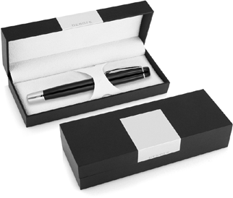
DER104 Metal Pen Rollerball Derofe Banker
Derofe Fine Writing Instruments have been delivering the best in pens since 1947, and the Banker Rollerball Pen continues the tradition in fine style.
With super smooth rollerball and black ink, this precision pen is immaculately presented in an elegant black giftbox and has a German Schmidt ceramic roller refill with 0.07mm nib with 500m capacity.
This black quality pen has chrome trim and can be printed or laser engraved (mirror chrome finish) with your client's promotional logo on the upper barrel and will satisfy those with a passion for writing.
*Pricing includes a 1 position laser engraved logo on the upper barrel. Setup and freight charges apply.
Rollerball
Black ink
FREE
German
laser
made
engrave*
rollerball
refill
Packaging info
Shipping Carton Qty: 500 Shipping Carton Size:
33.5 x 17.5 x 33.5cm (LxWxH) Carton Weight (kg): 18.5
Colours
Black CT
Engrave Area
Engrave (cap): 40 x 7mm
Engrave Colour: Mirror finish
FREE
gift box
FREE
2 year
warranty

