Slide 1
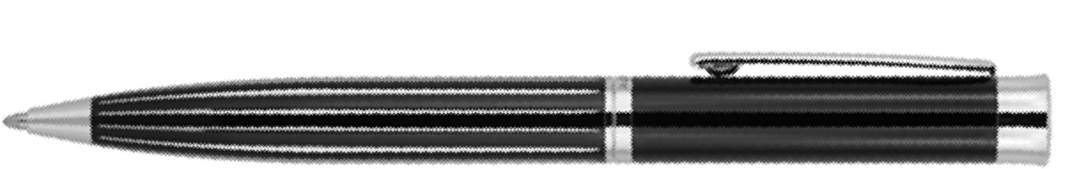
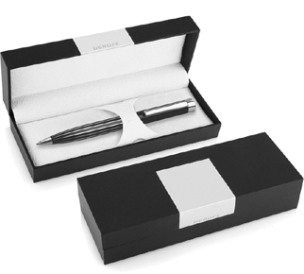
DER101 Metal Pen Ballpoint Derofe Stripe Black
Derofe Fine Writing Instruments presents the Stripe Black Ballpoint Pen in an elegant black gift box.
Laser engraved (mirror chrome finish) or pad printed with your client's promotional logo on the upper barrel, this exceptional pen is the epitome of integrity and quality.
Professionally equipped with Derofe Swiss metal refill (1.0mm nib and 9,300m capacity), this durable, black metal pen with chrome trim boasts a twist action, retractable ballpoint delivering black ink.
*Pricing includes a 1 position laser engraved logo on the upper barrel. Setup and freight charges apply.
Twist Action
Retractable ballpoint
Black ink
FREE
Swiss
laser
made
engrave*
ballpoint
refill
Packaging info
Shipping Carton Qty: 500 Shipping Carton Size:
33.5 x 17.5 x 33.5cm (LxWxH) Carton Weight (kg): 18.5
Colours
Black CT
Engrave Area
Engrave (upper barrel): 40 x 7mm
Engrave Colour: Mirror finish
FREE
gift box
FREE
2 year
warranty

