Slide 1
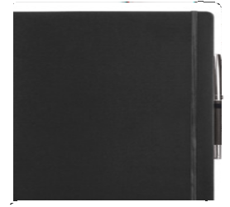
C507 Notebook Journal A4 Leather Look
soft
touch
Just like your favourite coffee cup, a great journal is a joy to use over and over again.
With handy features like a pen loop, ribbon bookmark, and elastic strap closure, your client's logo will be positioned perfectly on the PU cover of this prized and practical item, to be seen and remembered daily.
The FSC certified, lined pages are abundant so to maximise your client's return on investment.
Commodious A4 size.
High quality PU cover
Elastic closure
Ribbon bookmark
Quality, lined notebook paper -160 pages / 80 leaves
FSC approved
Packaging info
Product Dimension:
297 x 211 x 14mm Shipping Carton Qty: 50
Shipping Carton Size (LxWxH): 56 x 48.5 x 42cm
Shipping Carton Weight (kg): 13
Print Area
Pad: 60 x 30mm
Colors
A Black
Screen:
150 x 200mm
Digital:
70 x 40mm

