Slide 1
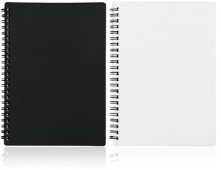
C496 Notebook A5 Spiral Bound
spiral
bound
Spiral bound
80 lined leaves of FSC approved paper
Wind your way to success with these spiral bound notebooks!
The simple PP cover is a brilliant location for your client's logo and the lush, FSC certified, lined paper is a delight to write on.
Keep your client's logo near at hand with this conveniently sized A5 notebook.
Packaging info
Product Dimension:
208 x 147 x 8mm Shipping Carton Qty: 72
Shipping Carton Size (LxWxH): 34 x 23 x 40cm
Shipping Carton Weight (kg): 15.40
Print Area
Pad: 60 x 30mm
Color
A Black B White
Screen:
80 x 150mm
Digital:
60 x 40mm
Digital:
80 x 30mm

