Slide 1
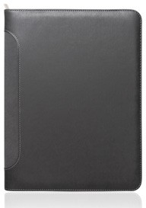
C487
Compendium A4 Roma Executive Zipper
Ultra soft
PU cover
Elegantly designed with an ultra-soft, leather-look PU finish and minimalist aesthetic, this zippered compendium features a notepad, sleeve, pen loop, and business card holders.
Ultra soft leather-look PU
Pen loop
A4 Notepad
Document sleeve
2x Business card holders
Pen not included
Packaging info
Product Dimension: 255 x 328 x 25mm
Shipping Carton Qty: 20 Shipping Carton Size:
52.5 x 27 x 34.5cm (LxWxH) Carton Weight (kg): 12
Print Area
Screen: 150 x 240mm
Colour
Grey
Full Colour Digital: 70 x 40mm

