Slide 1
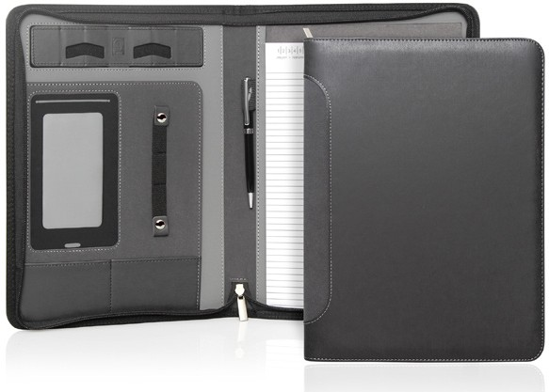
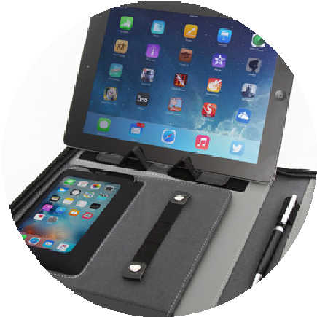
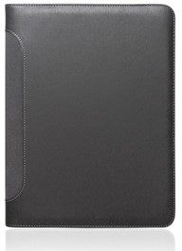
C485
Compendium A4
Verona Executive Tech Zipper
Ultra soft
PU cover
This beautifully designed, ultra soft, leather-look PU compendium includes those design features sought after by today's businessmen/women and students.
Including a Velcro adjustable tablet/phone stand, mobile phone sleeve (fits most phones) with a contact window, multiple card and accessory holders, pen loop, A4 notepad, and document sleeve.
Ultra soft leather-look PU
Velcro adjustable tablet/phone stand
Mobile phone sleeve
(fits most phones)
Business card and accessory holders
Pen loop
A4 notepad
Document sleeve
Pen not included
Packaging info
Product Dimension: 257 x 328 x 25mm
Shipping Carton Qty: 20 Shipping Carton Size:
52.5 x 27 x 34.55cm (LxWxH) Carton Weight (kg): 12.7
Print Area
Screen: 150 x 240mm
Colour
Grey
Full Colour Digital: 70 x 40mm

