Slide 1
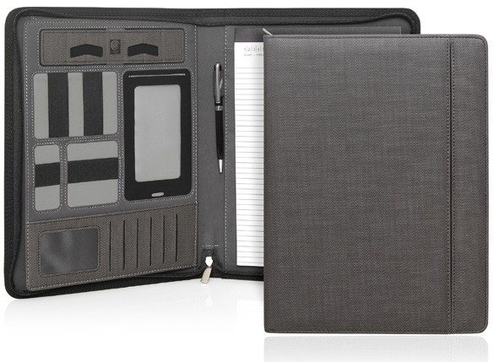
C480
Compendium A4 Milano Executive Tech Powerbank Zipper
with
power
bank
Italian
fabric
The Ultimate Compendium: Elegantly finished in Italian PU and with a charcoal herringbone pattern, this beautifully designed, feature packed compendium has all of the essential features required by the modern business man/woman or student.
Includes a large pocket, adjustable tablet/phone stand, mobile phone sleeve (fits most phones) with a touch sensitive contact window, multiple card and accessory holders, 5,000mAh powerbank (to charge Apple and Samsung devices), pen loop, and A4 notepad.
Sold in a retail quality gift box.
Italian PU
Large pocket
Adjustable tablet/phone stand
Mobile phone sleeve (fits most phones) with contact window
Card and accessory holders
5,000mAh powerbank
Pen loop, A4 notepad
Pen not included
Packaging info
Product Dimension: 264 x 337 x 35mm
Shipping Carton Qty: 10 Shipping Carton Size:
41.5 x 28.5 x 36cm (LxWxH) Carton Weight (kg): 9.7
Print Area
Full Colour Digital: 70 x 40mm
Colour
Charcoal

