Slide 1
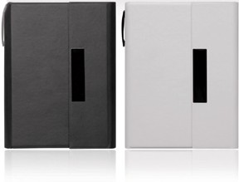
C474 Notepad A5 Folder Magnetic Closure Elegance
magnetic
closure
notepad
folder
This elegant notepad folder comes with a smooth, soft finish and a touch of style for your client's next executive promotion. Printed or laser engraved with your client's corporate logo it will look great and make a fine gift.
Notepad can be replaced by standard size refill. Paper is FSC approved.
Pen not included.
Standard 50 leaf notepad refill
Elegant folder with magnetic closure
Storage pouch inside front cover
Badge can be engraved or printed
Packaging info
Product Dimension:
178 x 240 x 15mm Shipping Carton Qty: 40
Shipping Carton Size (LxWxH): 42 x 40 x 26cm
Shipping Carton Weight (kg): 12
Print Area
100 x 16mm
(badge)
Engrave Area
100 x 16mm
(badge)
Colors
A Black B White

