Slide 1

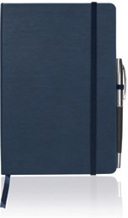
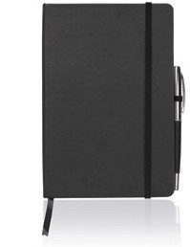
C460 Notebook Journal A5 Executive
two-tone
PU
soft
touch
This is a luxury notebook with quality paper and a fine, soft finish to the cover - ideal for your client's corporate or other promotional gift.
Printed with your client's logo or personalisation, this is an organisational tool that is bound to impress.
PU cover can be heat-stamped, creating a darker coloured imprint.
Pen not included.
Sophisticated hard PU cover
Unique darker colour appears when heat stamped
Quality, lined paper - 160 pages / 80 leaves
Elastic closure
Elastic pen holder
Ribbon bookmark
Useful storage folder inside back cover
Packaging info
Product Dimension:
214 x 145 x 18mm Shipping Carton Qty: 40
Shipping Carton Size (LxWxH): 45 x 31 x 20cm
Shipping Carton Weight (kg): 13
Print Area
Pad: 60 x 30mm
Screen:
80 x 150mm
Full Colour Digital:
60 x 40mm or 80 x 30mm
Colours
B Navy Blue C Black

