Slide 1
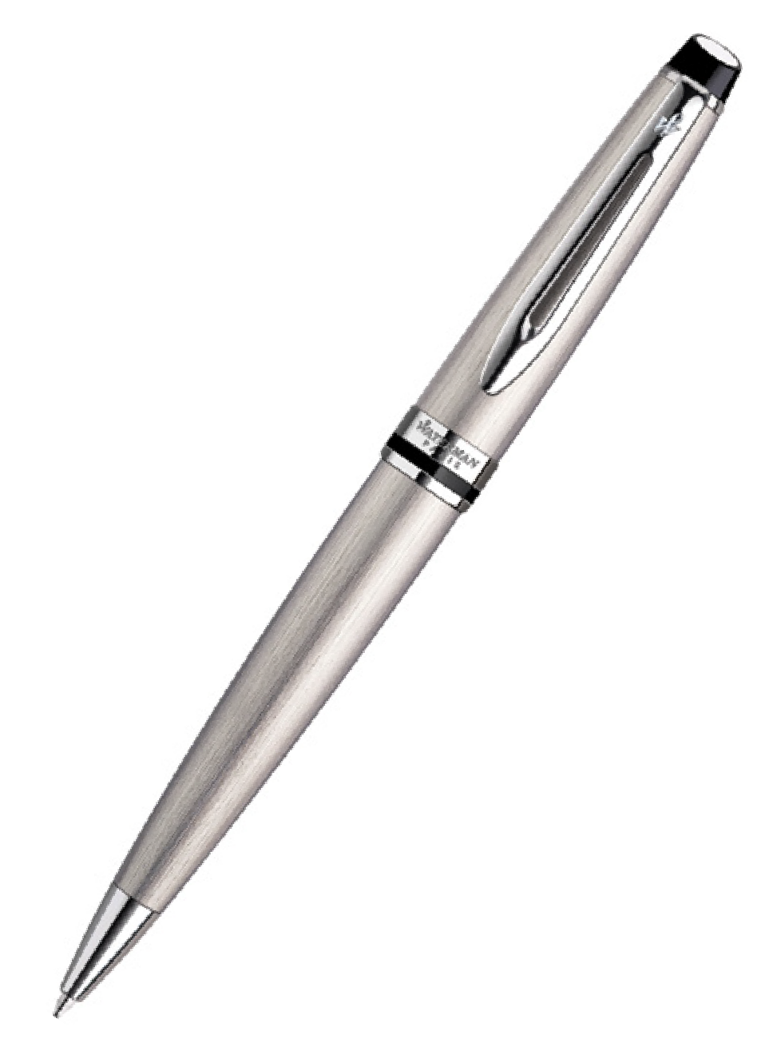
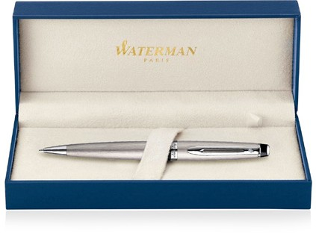
Expert Metal Pen Ballpoint Waterman Expert - Brushed Stainless CT MADE IN FRANCE AP013559 |  |  | Cap Decal Palladium Finish Barrel band: Palladium Finish Stainless Steel Finish | Cap Tassie Palladium Finish Clip Trim: Palladium Finish Barrel: Brushed Stainless Steel
Packaging info | Print Area
Shipping Carton Qty: 100 Shipping Carton Size: 41 x 38 x 38cm (LxWxH) Carton Weight (kg): 18.5 | Pad Print: 40 x 7mm Engrave Area Engrave: 40 x 7mm Engrave Color: Silver

