Slide 1
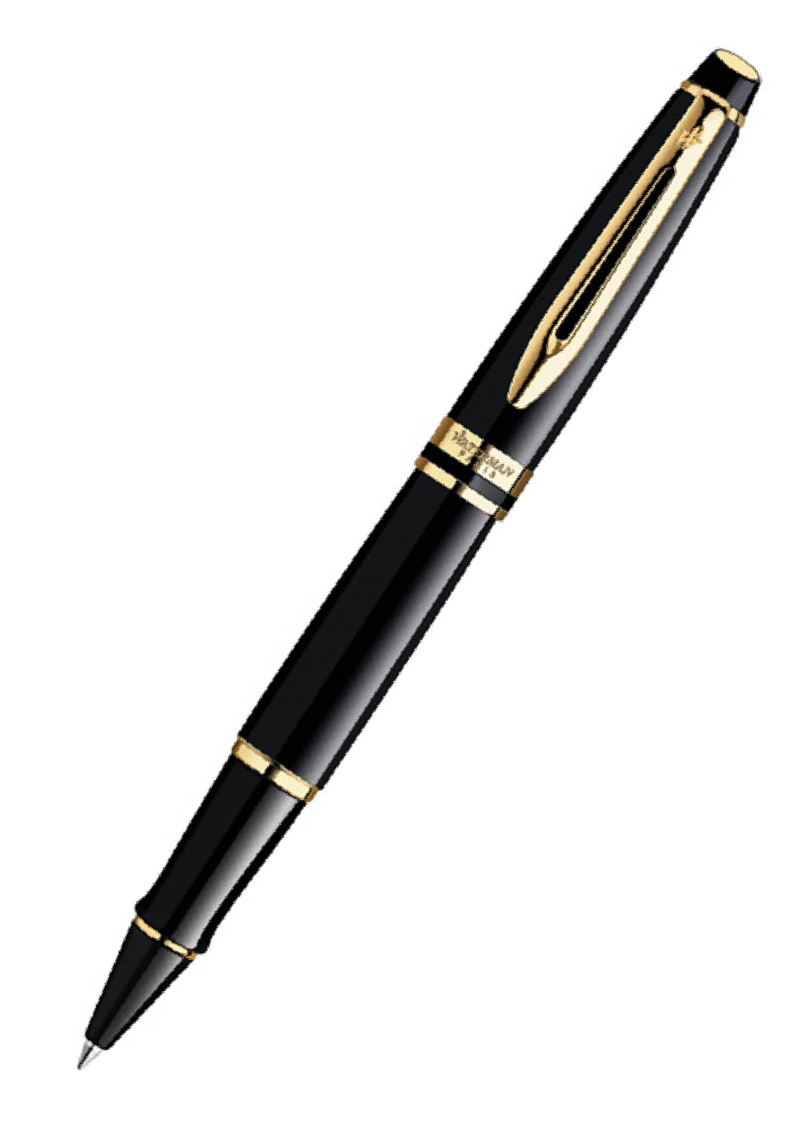
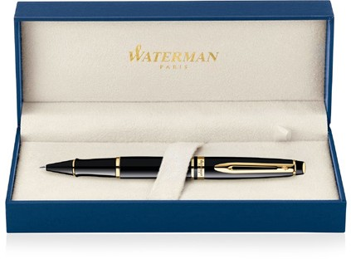
Cap Decal Cap Tassie Brass Gold Finish Brass Gold Finish Clip Trim: _{Expert} 23k Gold Finish Metal Pen Rollerball Waterman Expert - Lacquer Black GT MADE IN FRANCE _{AP013552} Barrel band: Brass 23K Gold Finish Barrel: Black Resin Black Resin
Packaging info Shipping Carton Qty: 100 Shipping Carton Size: 41 x 38 x 38cm (LxWxH) Carton Weight (kg): 18.5 | Print Area Pad Print: 40 x 7mm Engrave Area Engrave: 40 x 7mm Engrave Color: Gold

