Slide 1
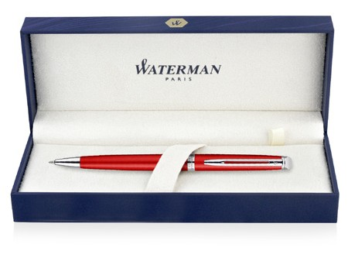
Cap Decal Cap Tassie Palladium Palladium Finish Finish Clip Trim: Hemisphere ^{Finish} Palladium Metal Pen Ballpoint Waterman Hemisphere - Comet Red CT MADE IN FRANCE 2042968 Barrel band: Palladium Finish Barrel: Linished and Varnished Stainless Steel Stainless Steel Finish
Packaging info Shipping Carton Qty: 80 Shipping Carton Size: 41.5 x 37.8 x 29.5cm (LxWxH) Carton Weight (kg): 17 | Print Area Pad Print: 40 x 7mm Engrave Area Engrave: 40 x 7mm Engrave Color: Gold

