Slide 1
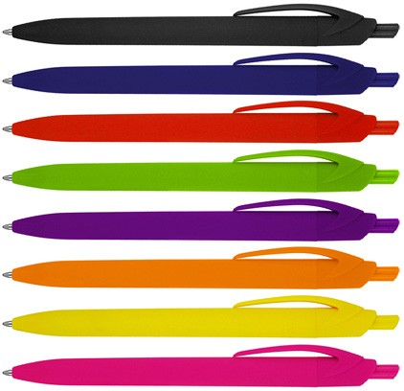
Z695 Plastic Pen Ballpoint Matte Rubber Mila
Slim type refill - 1,000m
Push Button
Retractable ballpoint
Black ink
push
quality
button
slim type
refill
Packaging info
Shipping Carton Qty: 1,000 Shipping Carton Size:
48 x 31 x 20cm (LxWxH) Carton Weight (kg): 8.5
Colours
A Black
B Blue
C Red
Print Area
Pad Print: 55 x 7mm
D Green
E Purple
F Orange
G Yellow H Pink

