Slide 1
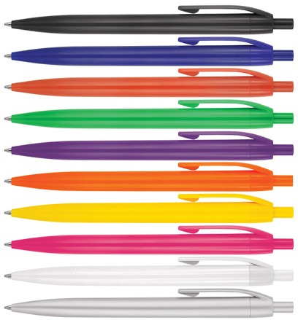
Z634 Plastic Pen Ballpoint Alida
The Alida Ballpoint Pen features a push button, revealing a black ink Slim type refill - German ink - 1,200m.
Printed with a company logo, this stylish promotional pen is an excellent branded gift idea for a corporate campaign.
Push button
Retractable ballpoint
Black ink
push
quality
button
slim
type refill
Packaging info
Shipping Carton Qty: 1,000 Shipping Carton Size:
53 x 31 x 22cm (LxWxH) Carton Weight (kg): 15
Colours
A Black
B White / Blue
C White / Red
Print Area
50 x 7mm
D Green
E Purple
F Orange
G Yellow
H Pink W White X Silver

