Slide 1
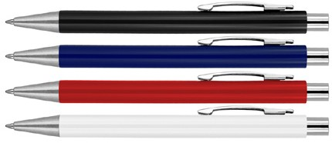
Z412 Plastic Pen Ballpoint Solid Colours Michaela
Sporting a modern, contemporary construction, the Michaela Plastic Solid Colours Ballpoint Pen is a statement on minimalist design.
Its 14g metal barrel houses a Parker type refill, with German ink rated for 4,000m, and its barrel is available in a range of colours.
Suitable for pad, digital and screen printing.
Click action
Retractable ballpoint
Black ink
Parker
click
type refill
action
Packaging info
Shipping Carton Qty: 1,000 Shipping Carton Size:
40 x 31 x 17cm (LxWxH) Carton Weight (kg): 8.5
Colours
A Black
B Navy
C Red
Print Area
Pad Print (barrel): 55 x 7mm
W White

