Slide 1
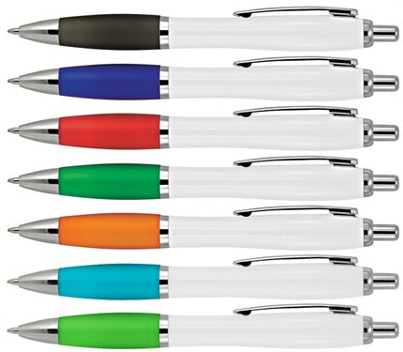
Z274 Plastic Pen Ballpoint White Cara
With push button, retractable ballpoint, the Cara White Ballpoint Pen is a classic and stylish quality option for your client's next promotion.
The barrel can be pad printed with logo branding to create a classy corporate gift. Black ink - Parker type refill - German ink - 4,000m.
Push button
Retractable ballpoint
Black ink
Parker
push
type refill
button
Packaging info
Shipping Carton Qty: 1,000 Shipping Carton Size:
53 x 31 x 22cm (LxWxH) Carton Weight (kg): 15
Colours
A Back
B Blue
Print Area
Pad Print (barrel): 50 x 7mm
C Red
D Green
E Orange
Light Blue
Light Green

