Slide 1
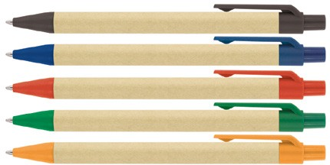
Z244 Eco Pen Ballpoint Recycled Paper Yoko
A great choice for promotions when wanting to emphasise eco credentials, the Yoko Recycled Paper Ballpoint Pen is made from recycled paper.
With a simple, sharp, modern profile and push button, retractable ballpoint, this ideal gift pen can be pad or screen printed with your client's logo in up to two positions on the barrel, giving them a variety of branding options.
The quality Slim type refill - German ink - 1,200m, delivers black ink.
Recycled paper pen
Push button
Retractable ballpoint
Black ink
quality
push
slim type
button
refill
Packaging info
Shipping Carton Qty: 1,000
Shipping Carton Size: 53 x 31 x 22cm (LxWxH)
Carton Weight (kg): 15
Colours
A Black
B Blue
C Red
Print Area
Pad Print (barrel): 50 x 6mm Screen Print (barrel): 50 x 20mm
D Green
E Orange

