Slide 1
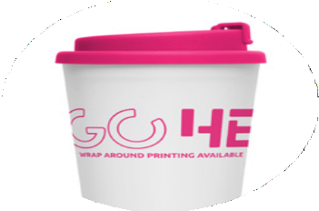
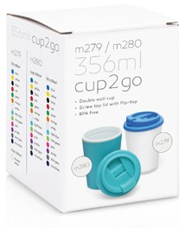
M279
Eco Coffee Cup
Plastic Double Wall Cup2Go Frosted 356ml
wrap
around
printing
available
Print Area
Screen print: 200 x 80mm Digital print: 26 x 80mm
White cup with many lid colours to choose from
356ml/12oz capacity
Screw-on threaded lid
Material: Food grade PP - BPA free
Packaging info
Product Dimension: ø90 x 135mm Shipping Carton Qty: 70
Shipping Carton Size:
59 x 42 x 32cm (LxWxH) Shipping Carton Weight (kg): 6
Optional gift box available for an additional charge
Colours
Cup Colour: White Frosted
Lid Colours:
LA
LB
LC
LD
LE
LF
LG
LH
LI
LJ
LK
LL
LM

