Slide 1
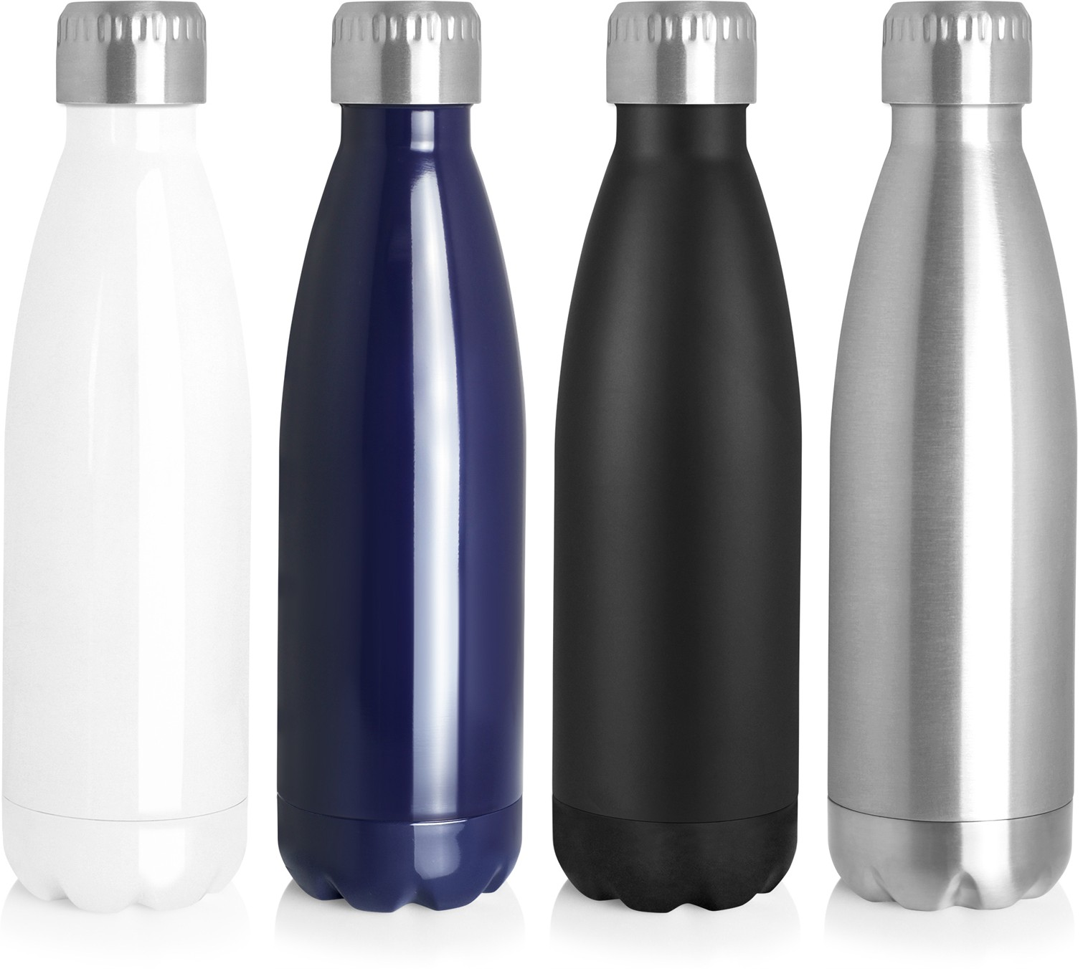
M271 Bottle Stainless 700ml
Stay hydrated with these stylish and practical stainless steel sports bottles; laser engraving beautifully and looking fantastic with a full colour digital print.
The bottle's usability and high visibility make it a brilliant printed promotional product. Students and fitness/outdoor enthusiasts will love them but, then again, so will anyone who likes to carry a little hydration with them... which as we ALL know these days is an important key to good health.
Not microwave or dishwasher safe. Sold in a retail quality gift box.
stainless
steel
bottles
Food grade #304 stainless
Flat top lid ideal for engraving
Not microwave or dishwasher safe
Print Area
Pad: 75 x 35mm Screen: 100 x 190mm Digital: 100 x 25mm
Engrave Area
100 x 25mm (bottle)
Ø30mm (lid)
Packaging info
Product Dimension: ø70 x 274mm Shipping Carton Qty: 25
Shipping Carton Size:
40 x 40 x 28.5cm (LxWxH) Shipping Carton Weight (kg): 7
Colours
Gloss White
Gloss Navy
Matte Black
Stainless

