Slide 1
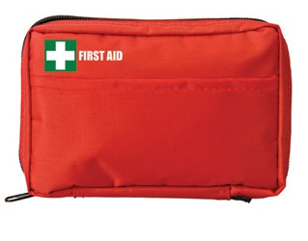
FA113 First Aid Kit Carry Pouch 30pc
Stay prepared with this 30 piece promotional First Aid Kit.
Holding a range of First Aid items within its durable polyester interior, this carry pouch design kit will always be on hand with your client's logo to the fore.
30pc First Aid Kit - Carry pouch wtih front pocket
Durable polyester pouch with compartments
5x small plasters
4x alcohol wipes
4x moist towelettes
2x PBT bandages
1x triangular bandage
5x non-woven pads
1x pair latex gloves
4x safety pins
1x scissors
1x tweezers
1x paper tape
1x First Aid information booklet
compact
& portable
Packaging info
Product Dimension: 145 x 85 x 50mm Shipping Carton Qty: 80
Shipping Carton Size: 53 x 39 x 55cm (LxWxH)
Carton Weight (kg): 10.5
Print Area
100 x 30mm
Colour
Red

