Slide 1
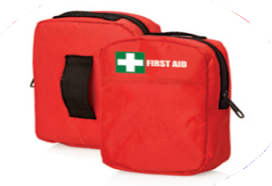
FA112 First Aid Kit Belt Pouch 30pc
Stay prepared with this 30 piece promotional First Aid Kit.
Holding a range of First Aid items within its durable polyester interior, this belt pouch design kit will always be on hand with your client's logo to the fore.
30pc First Aid Kit - Belt pouch with front pocket
Durable polyester pouch
5x small plasters
4x alcohol wipes
4x moist towelettes
2x PBT bandages
1x triangular bandage
5x non-woven pads
1x pair latex gloves
4x safety pins
1x scissors
1x tweezers
1x paper tape
1x First Aid information booklet
compact
& portable
Packaging info
Product Dimension: 130 x 95 x 45mm Shipping Carton Qty: 100
Shipping Carton Size: 56 x 38 x 55cm (LxWxH) Carton Weight (kg): 10
Print Area
60 x 60mm
Colour
Red

