Slide 1
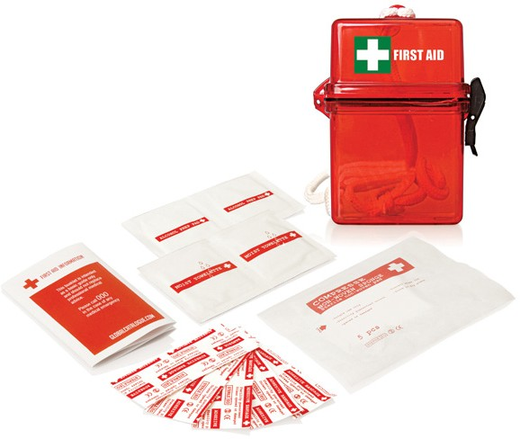
FA103 First Aid Kit Waterproof 15pc
water-
proof
Ideal for watersports or outdoor applications, these waterproof promotional first aid kits will display your client's logo in the best and most caring light.
15pc Waterproof First Aid Kit
Waterproof container protects the contents
5x small plasters
2x alcohol wipes
2x moist towelettes
5x non-woven pads
1x First Aid information booklet
Packaging info
Product Dimension: 120 x 90 x 35mm Shipping Carton Qty: 100
Shipping Carton Size:
52.5 x 43.5 x 32.5cm (LxWxH) Carton Weight (kg): 11
Print Area
35 x 20mm
Colour
Red transparent

