Slide 1
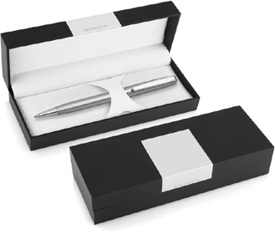
DER116 Metal Pen Ballpoint Derofe Connoisseur
The Connoisseur Silver Ballpoint Pen, with chrome trim, is presented by Derofe Fine Writing Instruments in an elegant giftbox. The twist action, retractable black ballpoint has print/engrave included.
Available pad printed or laser engraved (mirror chrome finish) with your client's promotional logo to the upper barrel or choose to personalise with the recipient's name.
Derofe Swiss metal refill (1.0mm nib and 9,300m capacity).
*Pricing includes a 1 position laser engraved logo on the upper barrel. Setup and freight charges apply.
Twist Action
Retractable ballpoint
Black ink
FREE
Swiss
laser
made
engrave*
ballpoint
refill
Packaging info
Shipping Carton Qty: 500 Shipping Carton Size:
33.5 x 17.5 x 33.5cm (LxWxH) Carton Weight (kg): 18.5
Colours
Silver CT
Engrave Area
Engrave (upper barrel): 40 x 7mm
Engrave Colour: Mirror finish
FREE
gift box
FREE
2 year
warranty

