Slide 1
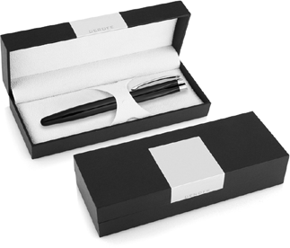
DER106 Metal Pen Rollerball Derofe Hexagonal
With the Hexagonal Rollerball Pen, another quality Derofe Fine Writing Instrument is born and presented in a stylish black gift box. Print/ engrave is included in the price.
The German Schmidt ceramic roller refill (0.07mm - 500m) delivers black ink in a style appropriate to the elegant black finish with chrome trim.
Can be printed or laser engraved (mirror chrome finish) with your client's promotional logo or name on the barrel to create a personalised gift of integrity, style and quality.
*Pricing includes a 1 position laser engraved logo on the upper barrel. Setup and freight charges apply.
Rollerball
Black ink
FREE
German
laser
made
engrave*
rollerball
refill
Packaging info
Shipping Carton Qty: 500 Shipping Carton Size:
33.5 x 17.5 x 33.5cm (LxWxH) Carton Weight (kg): 18.5
Colours
Black CT
Engrave Area
Engrave (cap): 40 x 7mm
Engrave Colour: Mirror finish
FREE
gift box
FREE
2 year
warranty

