Slide 1
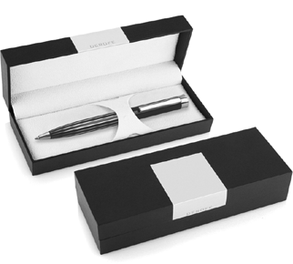
DER103 Metal Pen Ballpoint Derofe Banker
Derofe Fine Writing Instruments have been delivering the best in pens since 1947, and the Banker Ballpoint Pen continues the tradition in fine style.
With twist action, retractable ballpoint and black ink, this precision pen is immaculately presented in an elegant black giftbox. Refills have 1.0mm nibs and 9,300m capacity.
This black, quality pen has a chrome trim and can be printed or laser engraved (mirror chrome finish) with your client's promotional logo on the upper barrel and will satisfy those with a passion for writing.
*Pricing includes a 1 position laser engraved logo on the upper barrel. Setup and freight charges apply.
Twist Action
Retractable ballpoint
Black ink
FREE
Swiss
laser
made
engrave*
ballpoint
refill
Packaging info
Shipping Carton Qty: 500 Shipping Carton Size:
33.5 x 17.5 x 33.5cm (LxWxH) Carton Weight (kg): 18.5
Colours
Black CT
Engrave Area
Engrave (upper barrel): 40 x 8mm
Engrave Colour: Mirror finish
FREE
gift box
FREE
2 year
warranty

