Slide 1
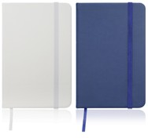
C505 Notebook Journal A6 Leather Look
High quality PU cover
Elastic closure
Ribbon bookmark
Quality, lined notebook paper - 160 pages / 80 leaves
FSC approved
Just like your favourite coffee cup, a great journal is a joy to use over and over again.
With handy features like a pen loop, ribbon bookmark, and elastic strap closure, your client's logo will be positioned perfectly on the PU cover of this prized and practical item, to be seen and remembered daily.
The FSC certified, lined pages are abundant so to maximise your client's return on investment.
Pocket-sized A6.
Packaging info
Product Dimension:
139 x 91 x 14mm Shipping Carton Qty: 100
Shipping Carton Size (LxWxH): 39 x 29.5 x 20cm
Shipping Carton Weight (kg): 12.8
Print Area
Pad: 50 x 30mm
Color
B White C Navy
Blue
Screen:
50 x 100mm
Digital:
60 x 40mm

