Slide 1
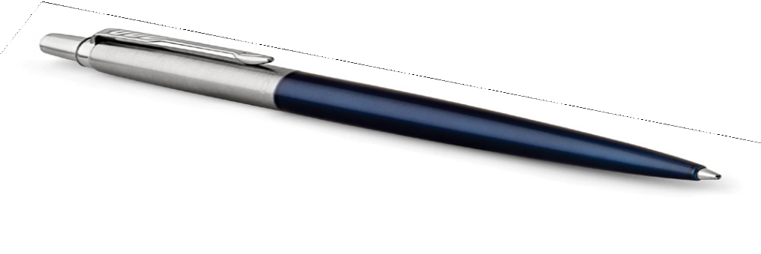
Jotter Metal Pen Ballpoint Parker Jotter - Royal Blue CT MADE IN FRANCE 1953347 |  | Cap : Linished Stainless Steel |  | Clip Trim: Stainless Steel Barrel: Linished and Varnished Stainless Steel
Packaging info | Print Area
Shipping Carton Qty: 300 Shipping Carton Size: 60.1 x 37.2 x 27.6cm (LxWxH) Carton Weight (kg): 18.1 | Pad Print: 40 x 7mm Engrave Area Engrave: 40 x 7mm Engrave Color: Silver

